Slide 1


Market Movers
Dora Do , Sean Ng , Brian Phung , Nicole Ransome, Noemi Ventura , Hannah Yang

Slide 2
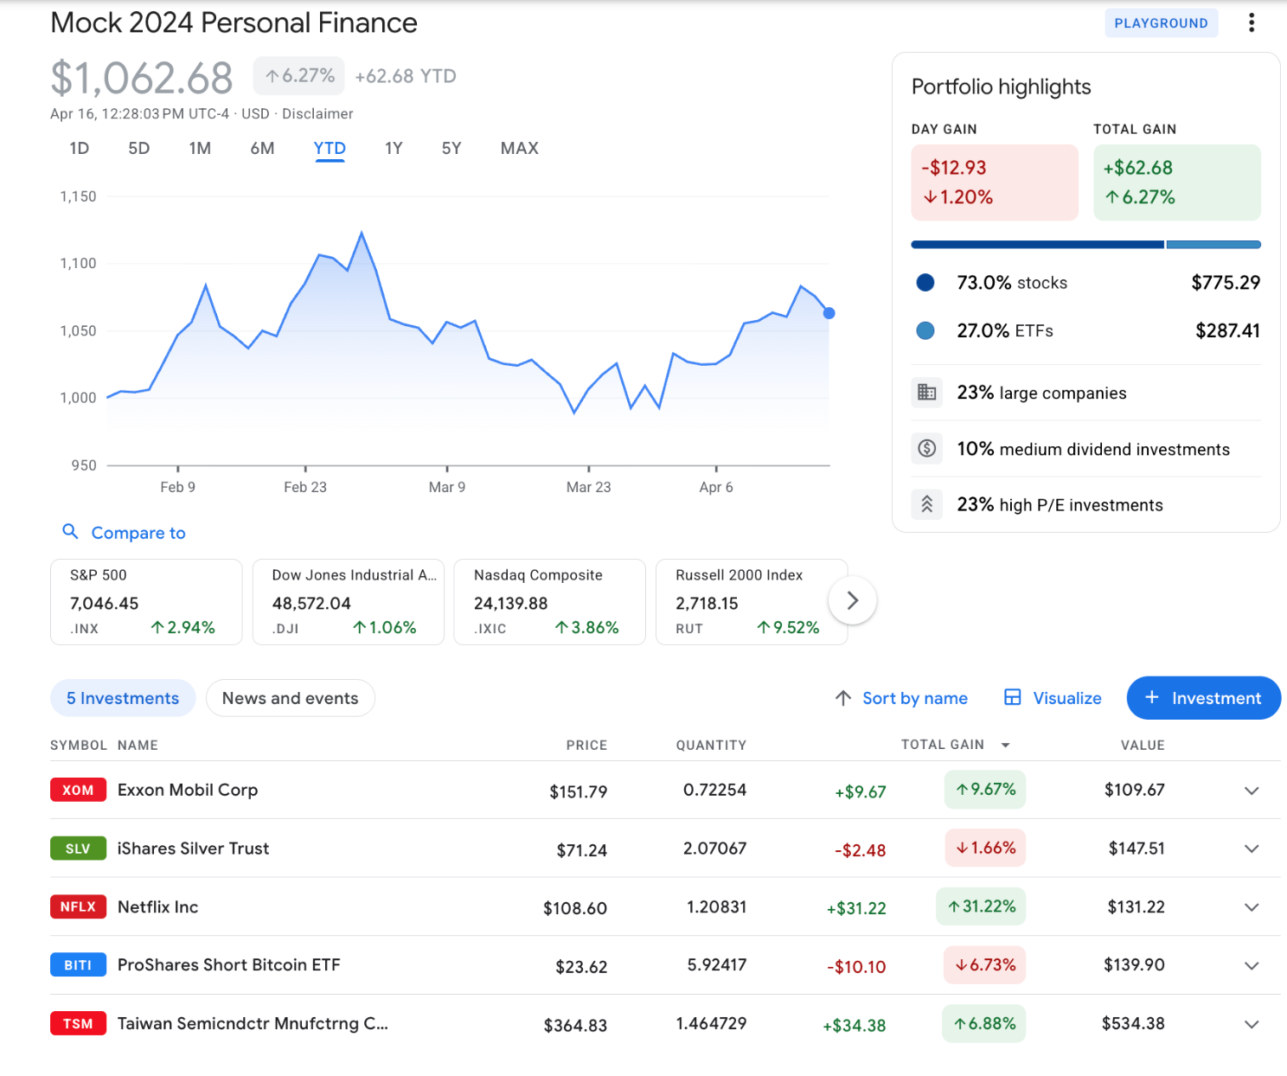
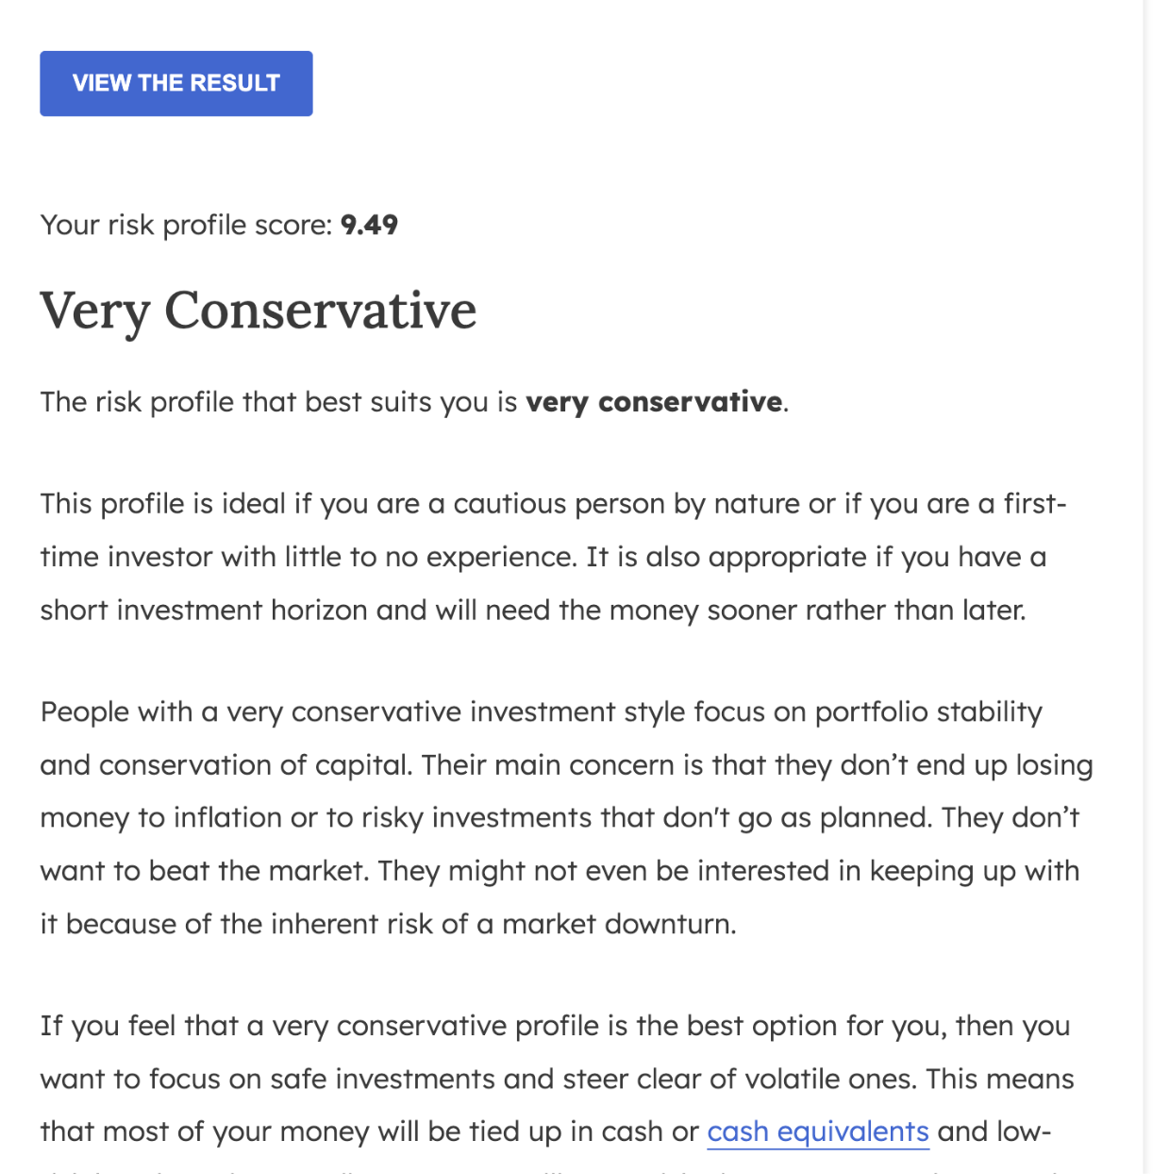
Sean Ng - Very Conservative

Slide 3
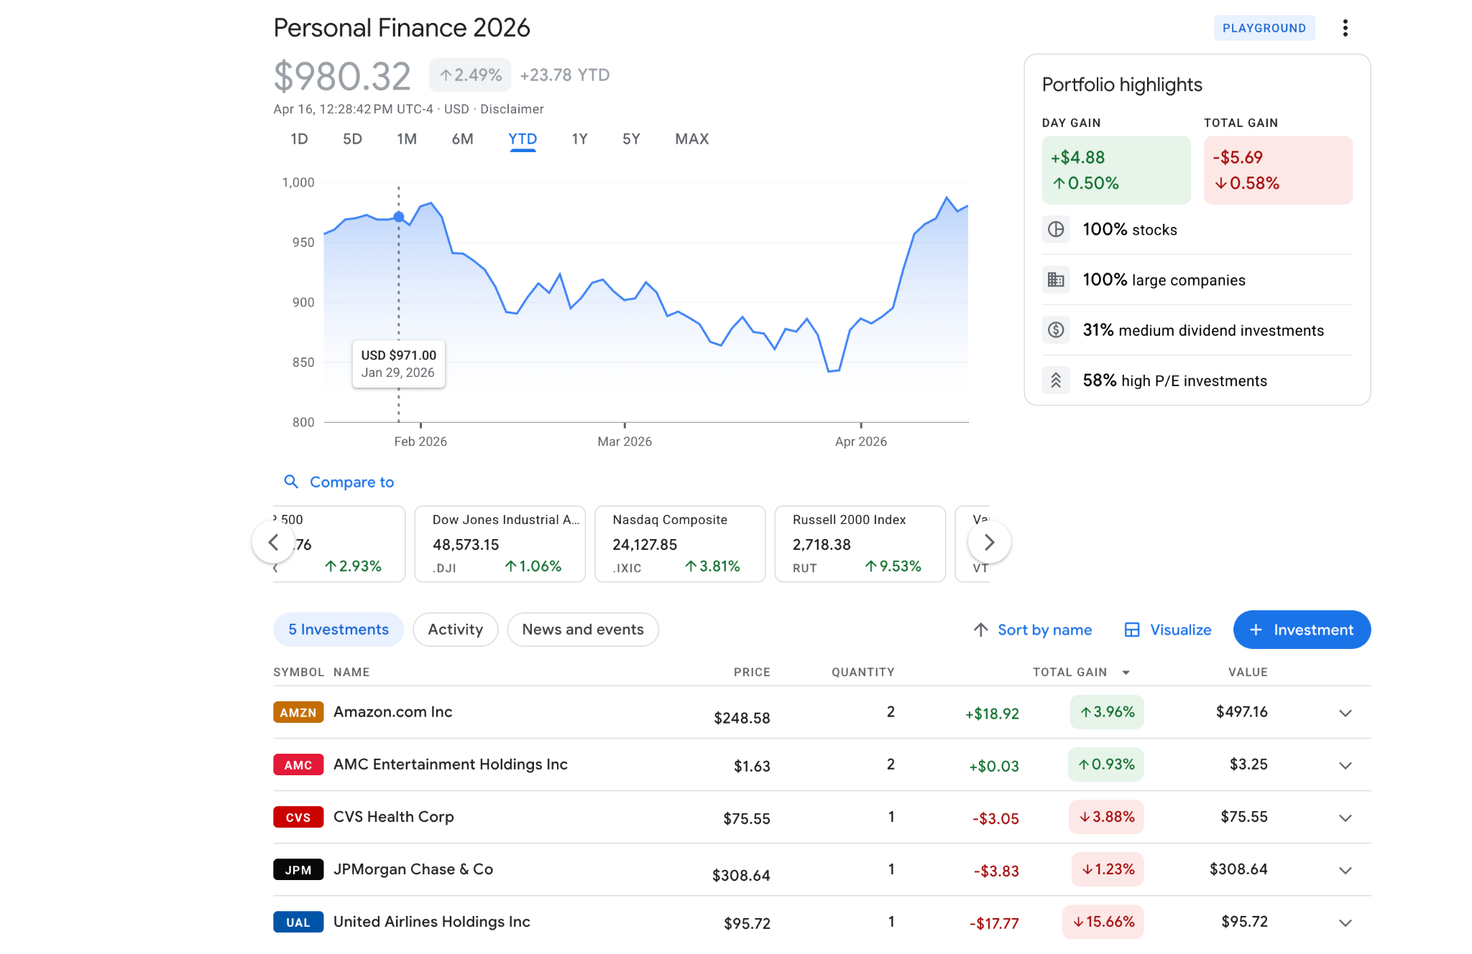
Noemi Ventura - Conservative

Slide 4
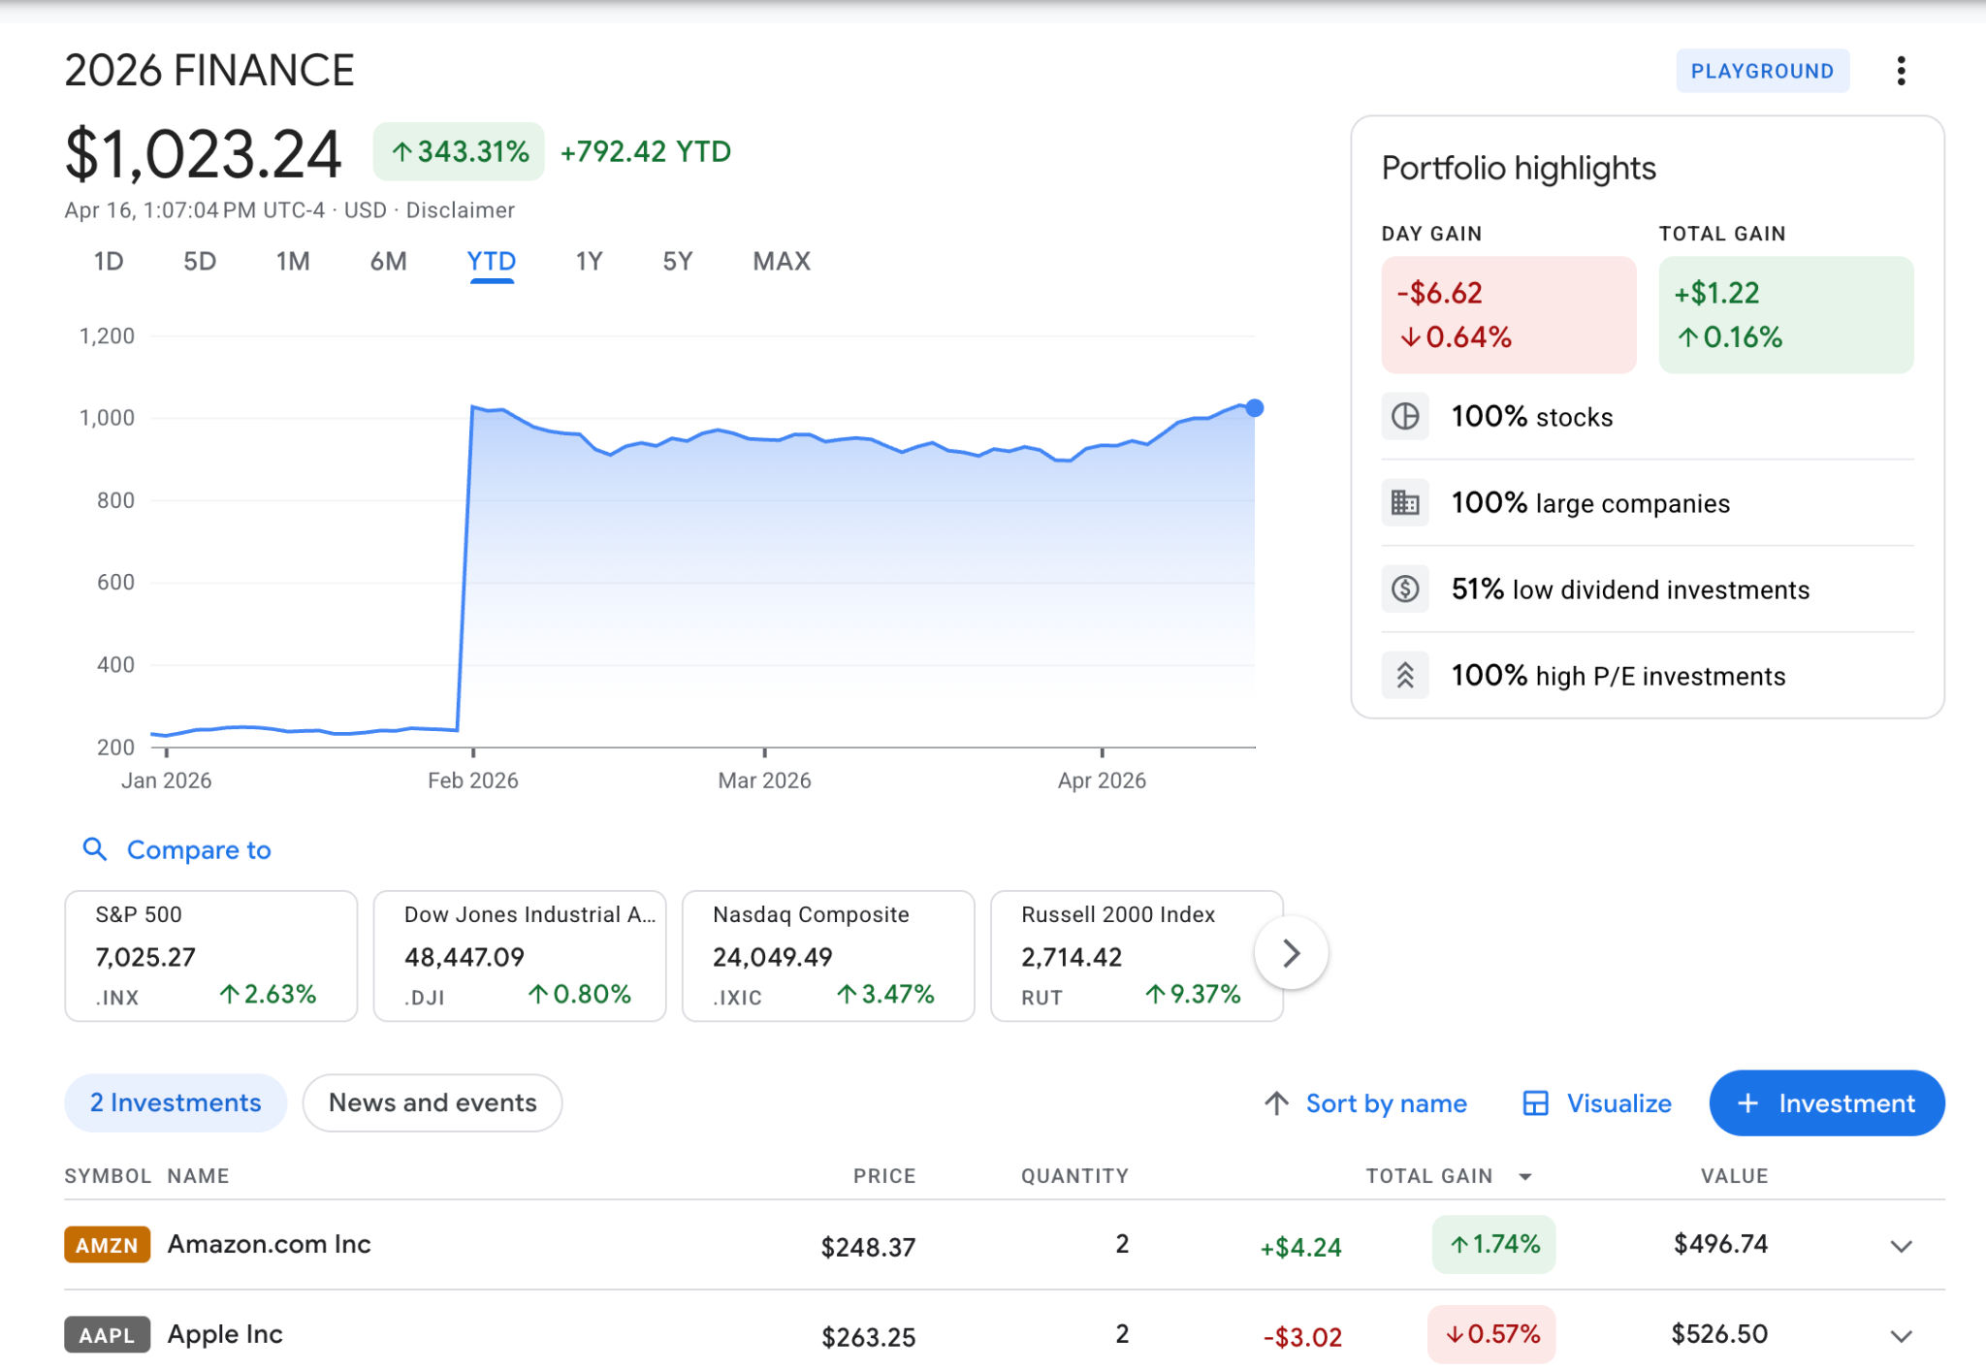
Dora, Very Conservative

Slide 5
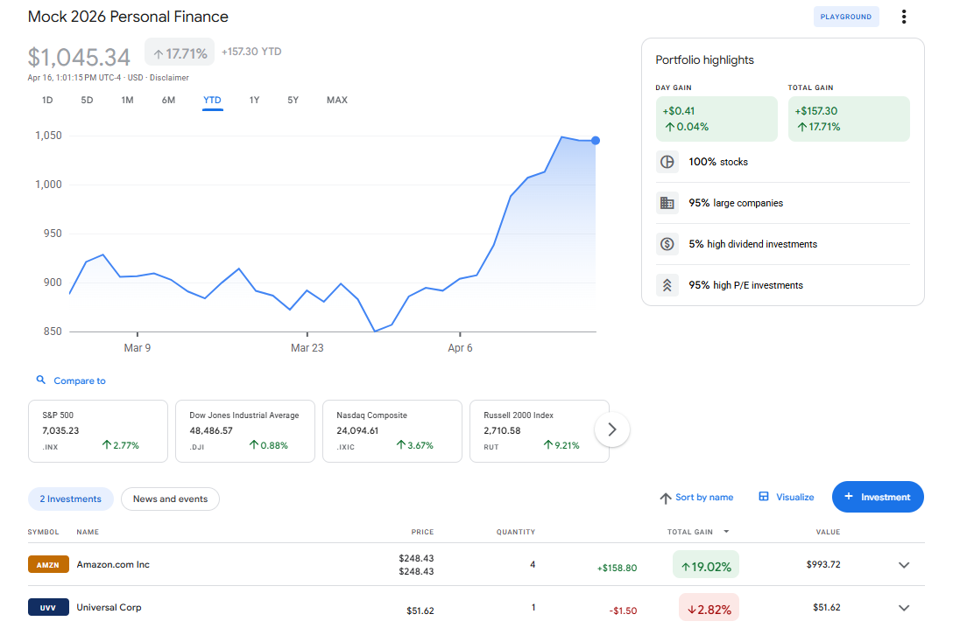
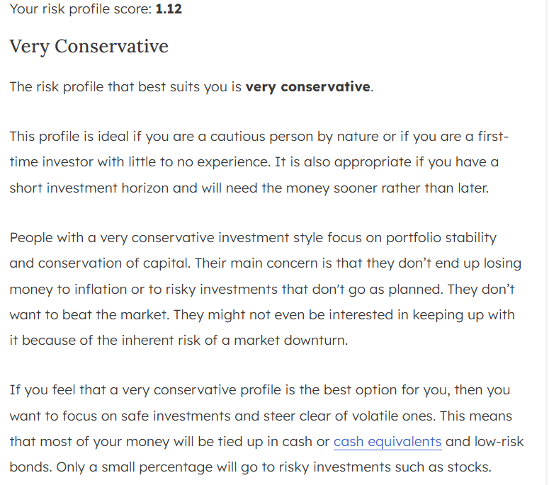
Hannah Yang - Very Conservative

Slide 6
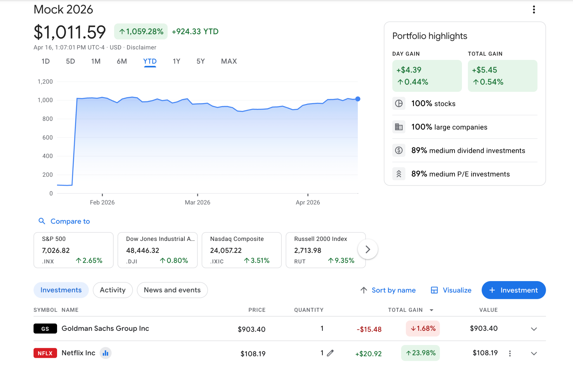
Brian - Conservative

Slide 7
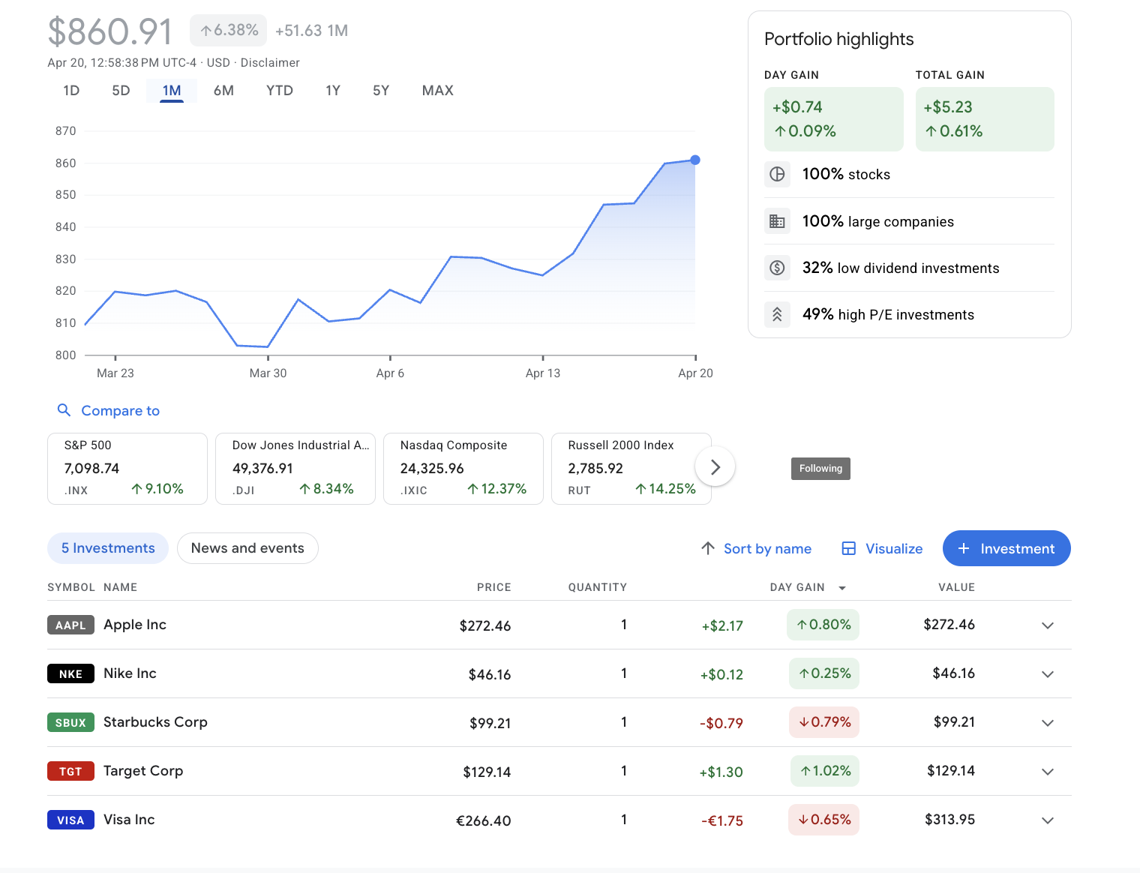
Nicole Ransome - Moderate/Conservative

Slide 8
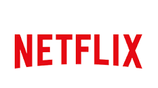

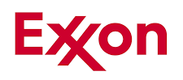
Top 3 Investments
 | Netflix | Amazon | Exxon Mobil Corp
Price/Earnings Ratio: | 42.83 | 34.68 | 21.90
Earnings Per Share: | 0.56 | 7.17 | 6.99
Profit Margin: | 8.77% | 16.58% | -10.37%
Total Gain | ↑ 31% | ↑ 19% | ↑ 9%

Slide 9
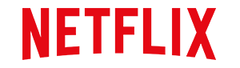
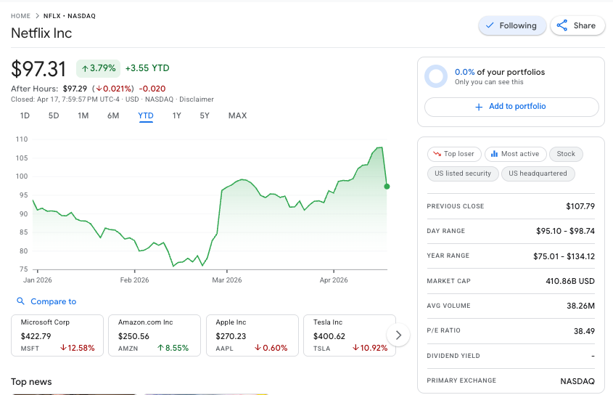
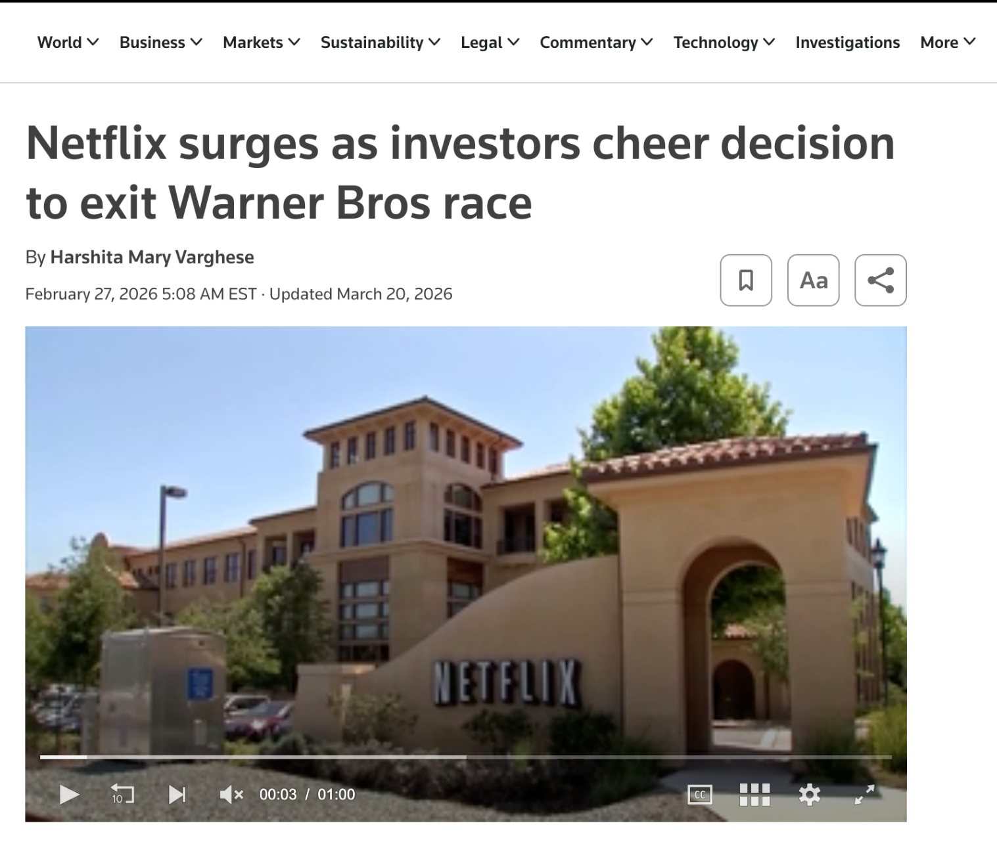
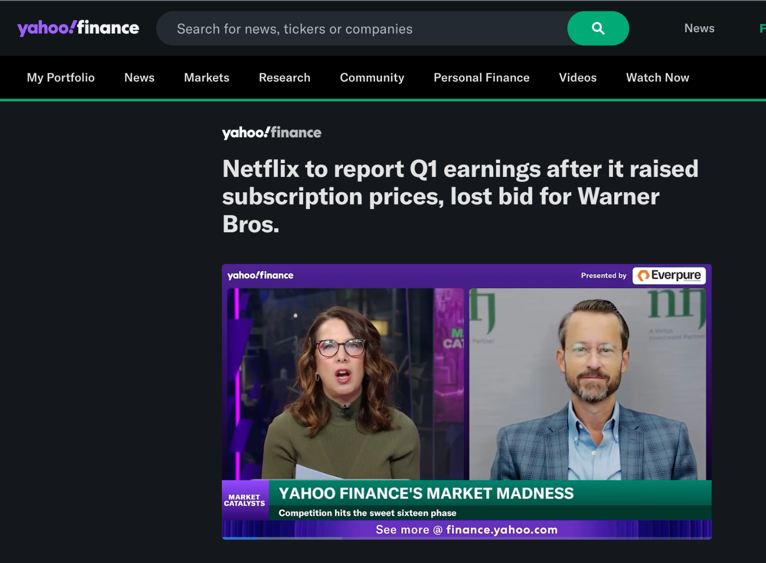
Top Performing Company - Netflix(NFLX)
Market Capitalization: 410.80 Billion USD (Mega-Cap)
(2) We discontinued our DVD-by-mail service in the year ended December 31, 2023. The discontinuance of our DVD business had an immaterial impact on our operations and financial results.

Slide 10
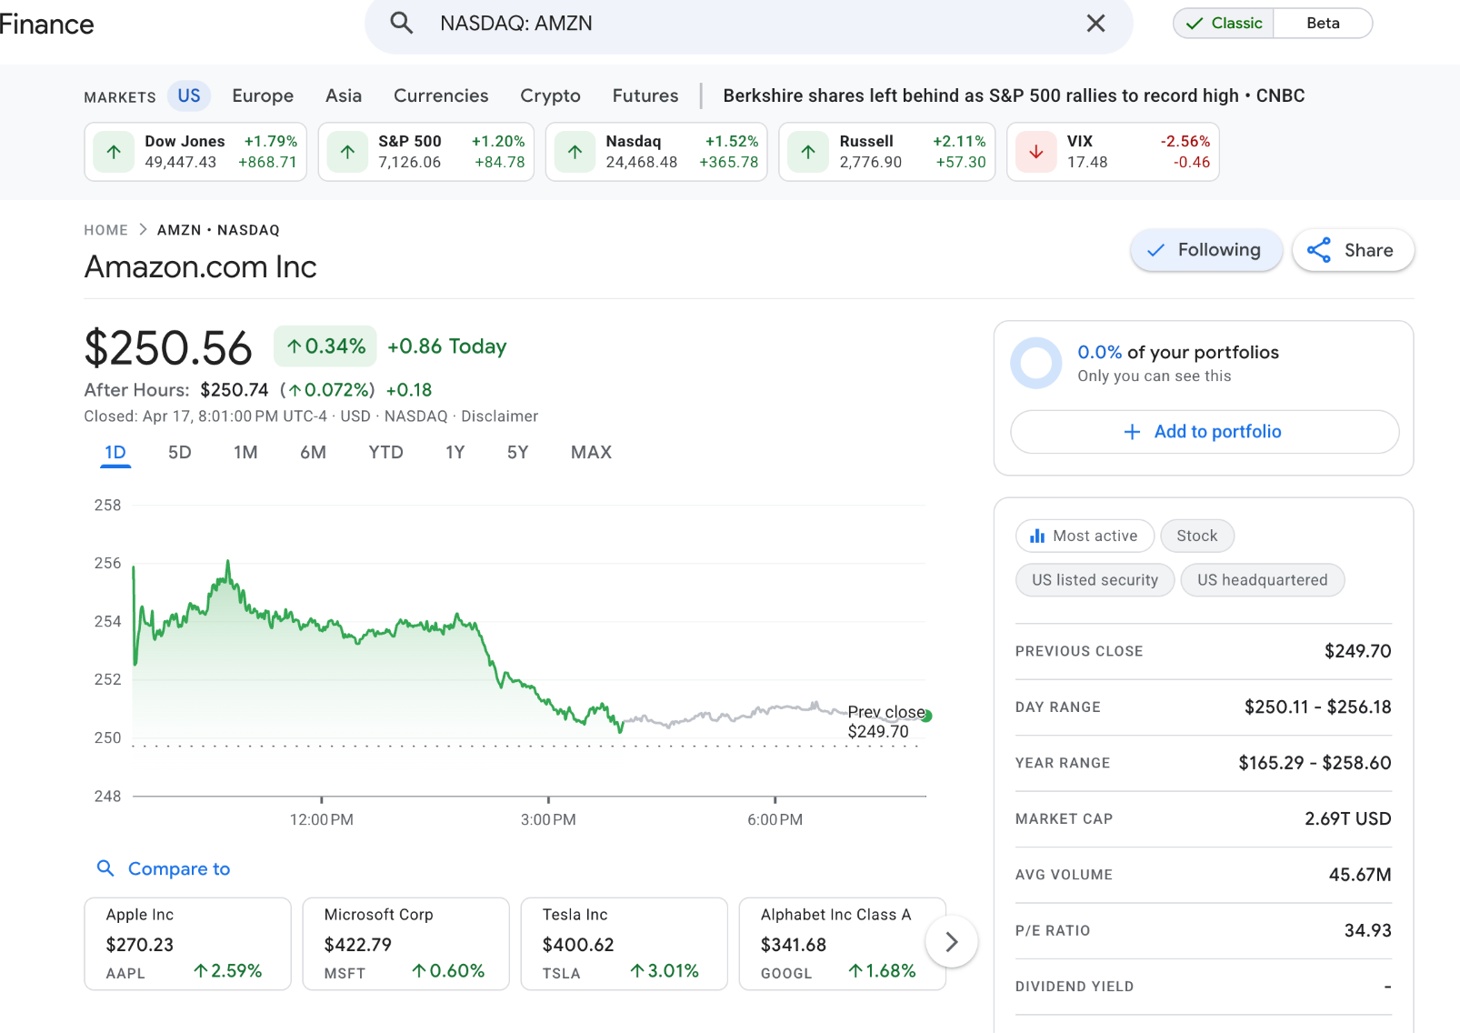
Top Performing Company - Amazon.com Inc(AMZN)
Market Capitalization: 2.69T USD
Range: Mega-cap.
Amazon’s net sales increased from about $638 billion to $717 billion, driven mainly by strong growth in AWS, which remains its most important and profitable segment.
Operating income also rose from about $68.6 billion to $80.0 billion, although higher costs in fulfillment, shipping, and technology infrastructure partially offset these gains.
Amazon significantly increased its investments in AI, AWS, and infrastructure, which caused free cash flow to drop from about $38 billion to $11 billion, reflecting a focus on long-term growth over short-term cash returns.

Slide 11

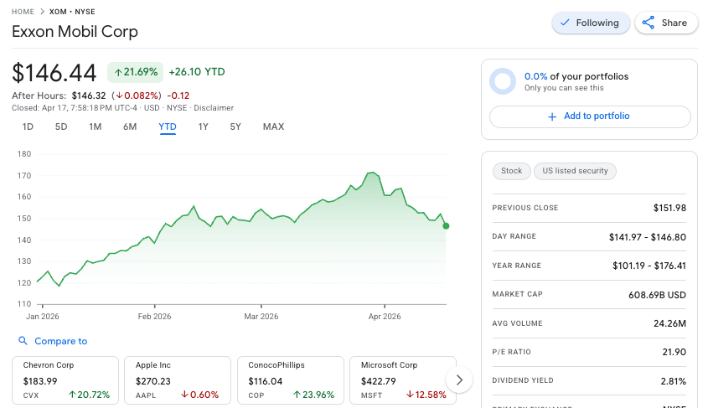
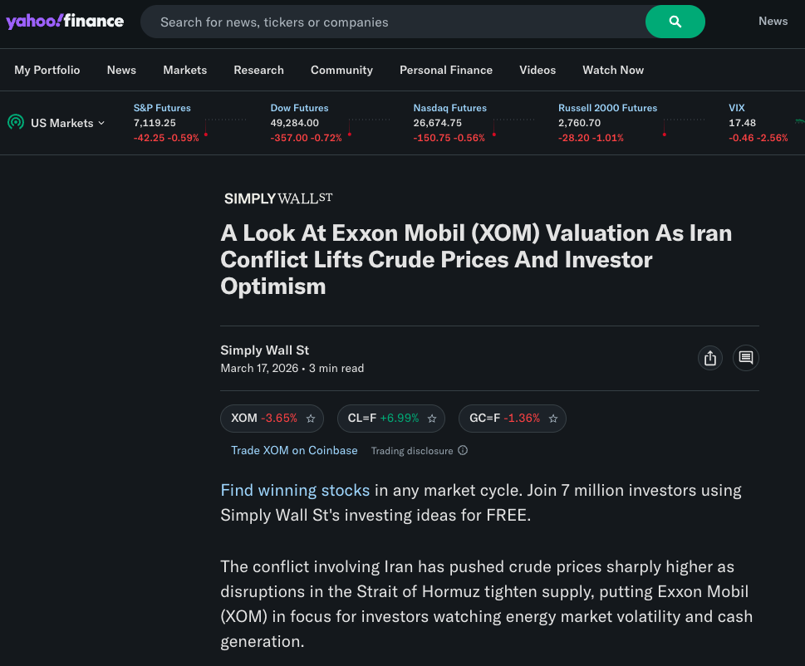

Top Performing Company - Exxon Mobil Corp(XOM)
Market Capitalization: 609.69 Billion USD (Mega-Cap)
Pursuit of lower-emission and other new business opportunities, including carbon capture and storage, hydrogen and ammonia, lower-emission fuels, ProxximaTM resin systems, carbon materials, low-carbon data centers, and lithium.

Slide 12


What We Would Do Differently Today
Define a goal, choose a time frame, and determine our risk tolerance
Read key financial documents like 10-K and MD&A section
Look at industry trends and overall market sentiment

